Slide 1
Microsoft 365 Enterprise
License Map – February 2020
@AaronDinnage

Slide 2
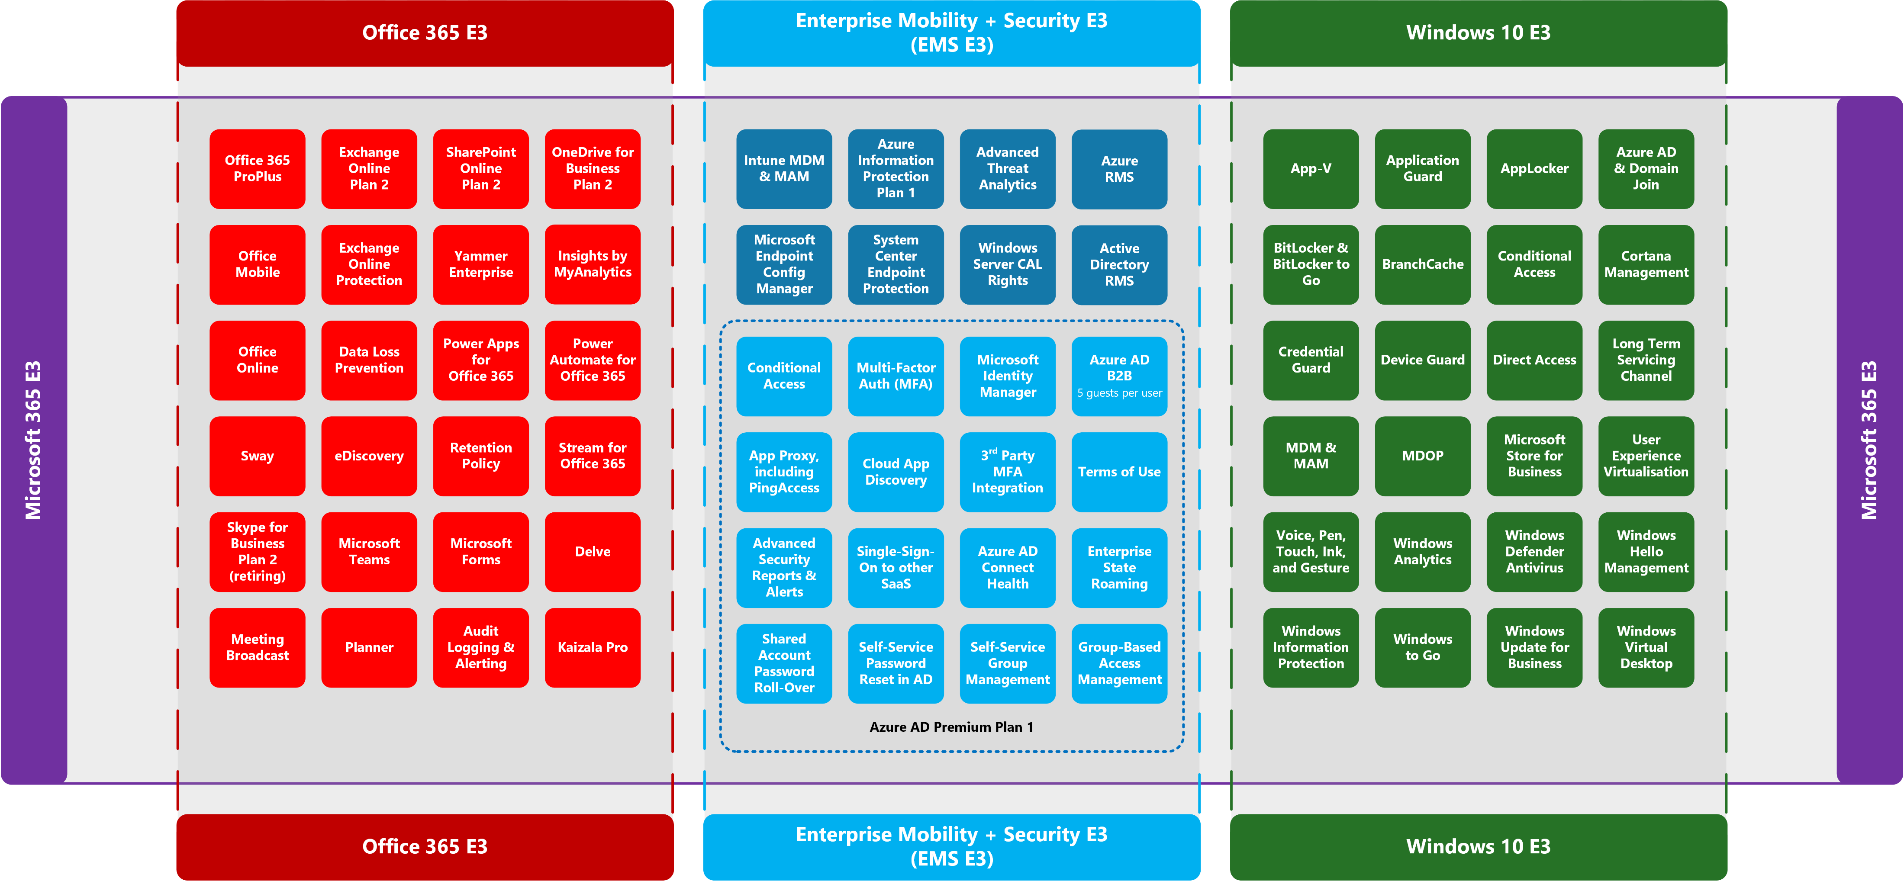
Latest diagrams available here: https://github.com/AaronDinnage/Licensing
Notes:
This is a map of all Microsoft 365 E3 / VSA 4 CCC components in Office 365, EMS, and Windows 10. Each tile is clickable to find more information.

Slide 3
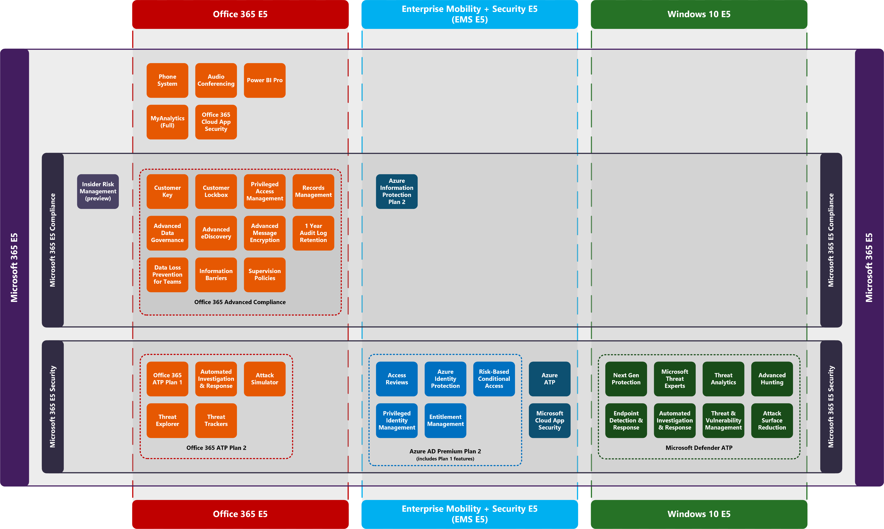
Latest diagrams available here: https://github.com/AaronDinnage/Licensing
Notes:
This is a map of all Microsoft 365 E5 components in Office 365, EMS, and Windows 10. As before, each tile is clickable to find more information.

Slide 4
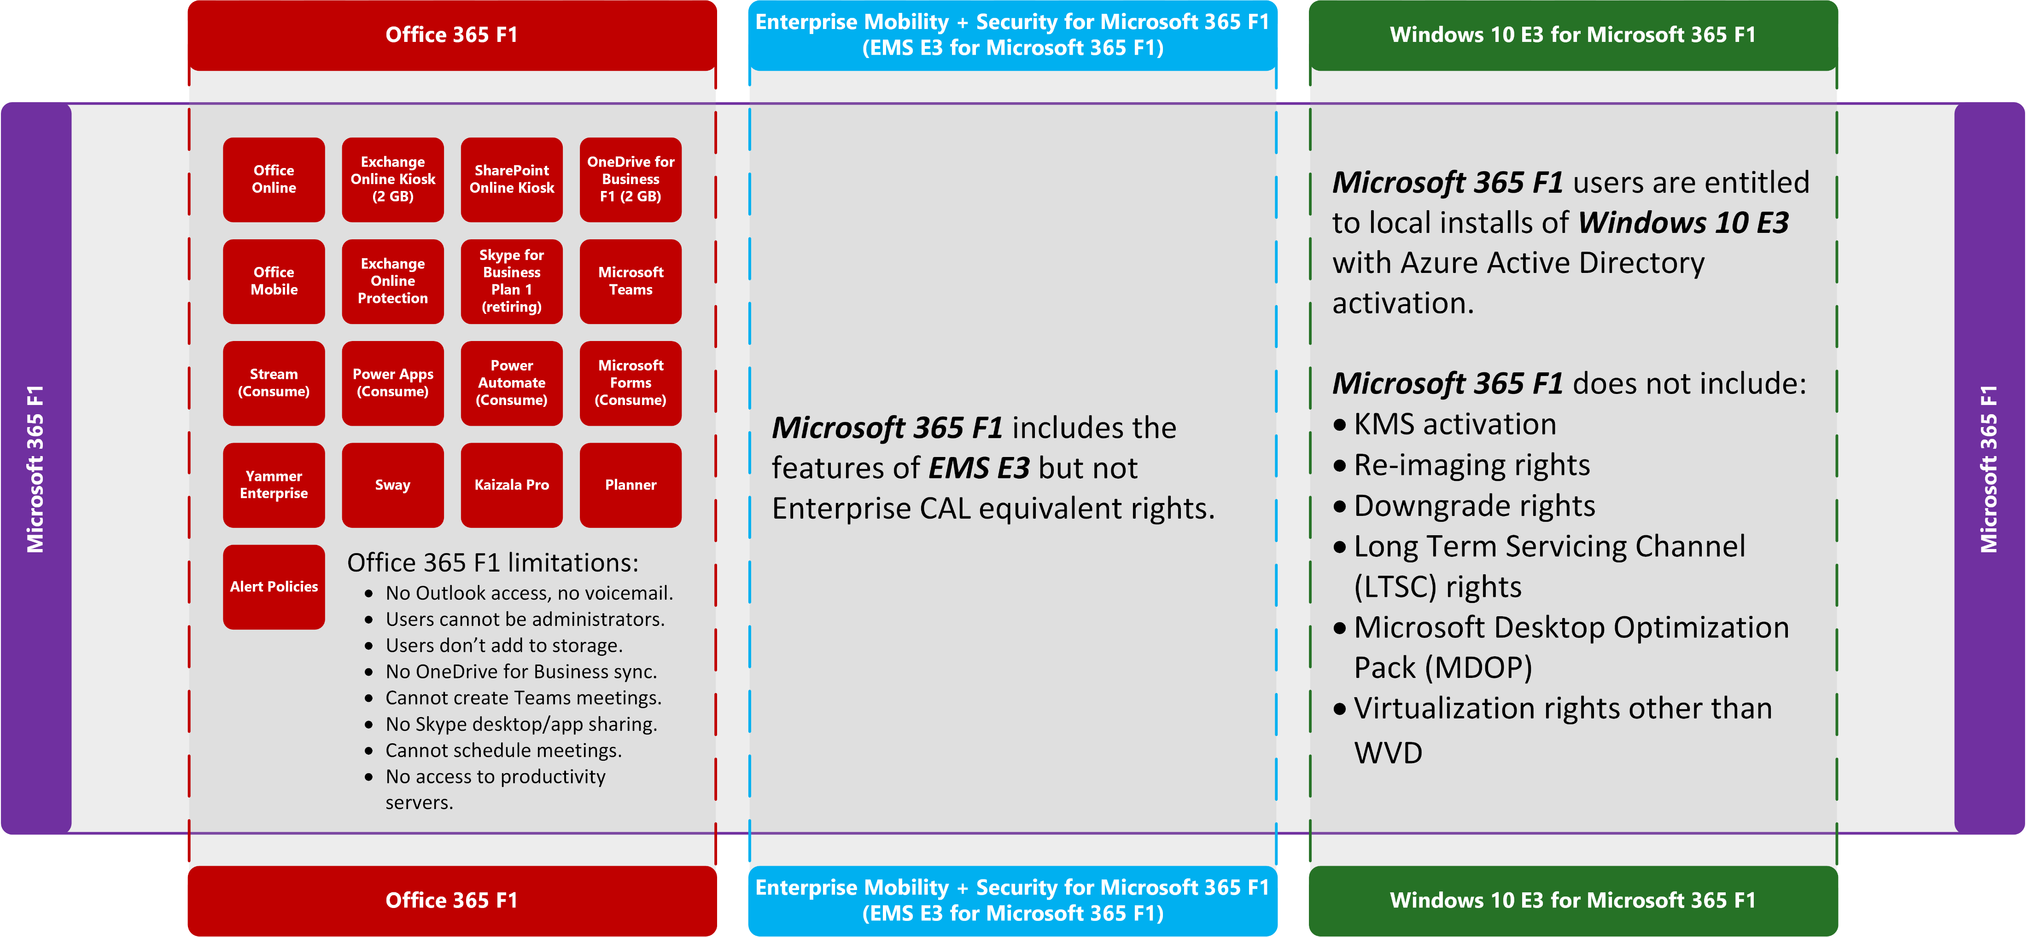
Latest diagrams available here: https://github.com/AaronDinnage/Licensing
Notes:
This is a map of all Microsoft 365 E3 / VSA 4 CCC components in Office 365, EMS, and Windows 10. Each tile is clickable to find more information.

Slide 5
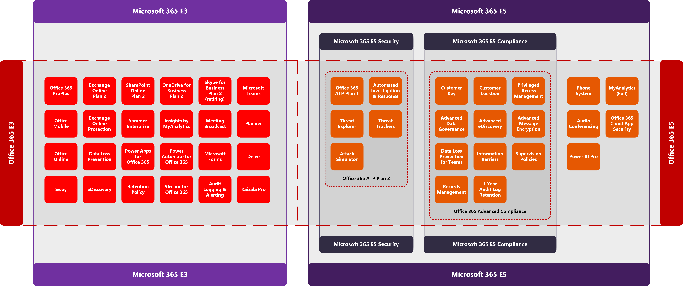
Latest diagrams available here: https://github.com/AaronDinnage/Licensing

Slide 6
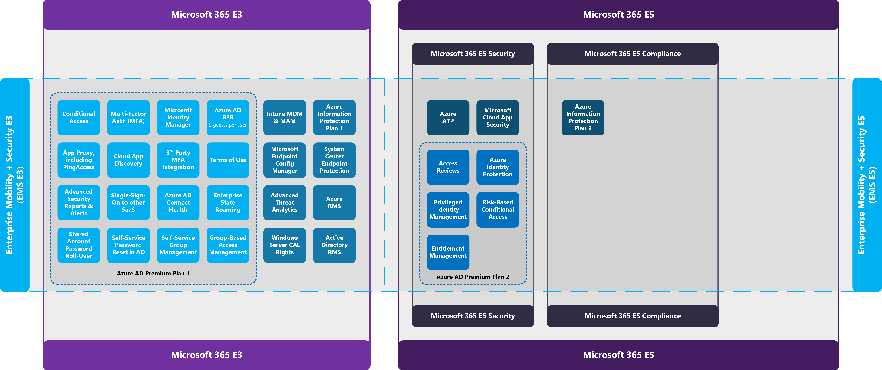
Latest diagrams available here: https://github.com/AaronDinnage/Licensing

Slide 7
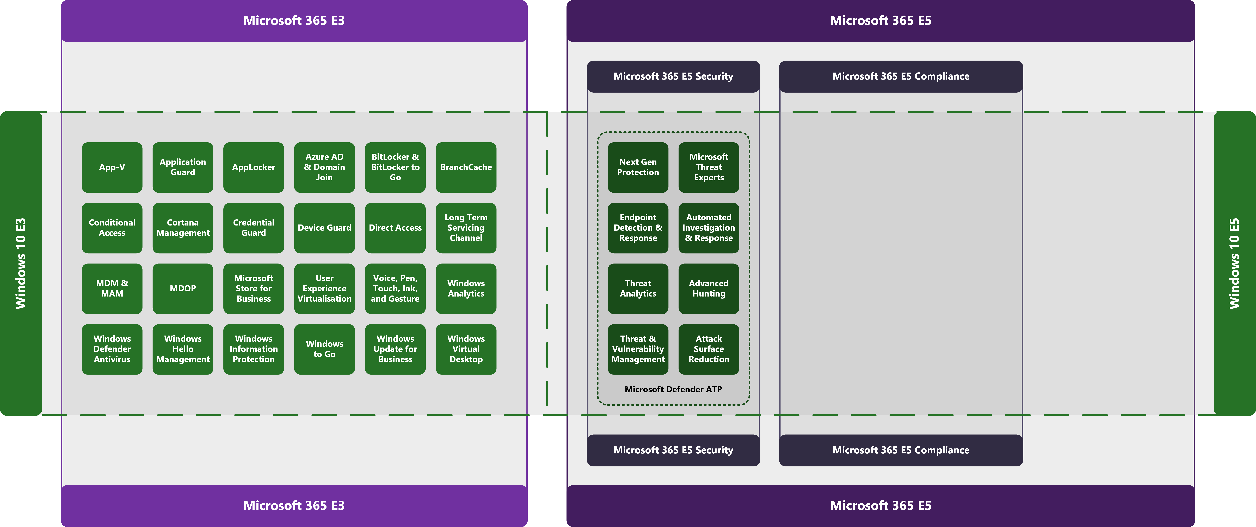
Latest diagrams available here: https://github.com/AaronDinnage/Licensing

Slide 8
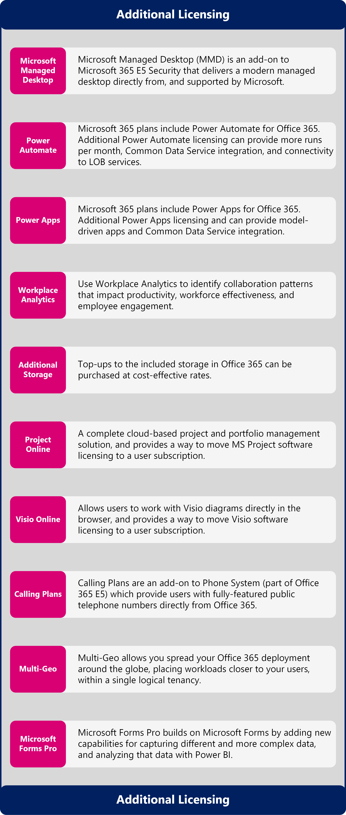
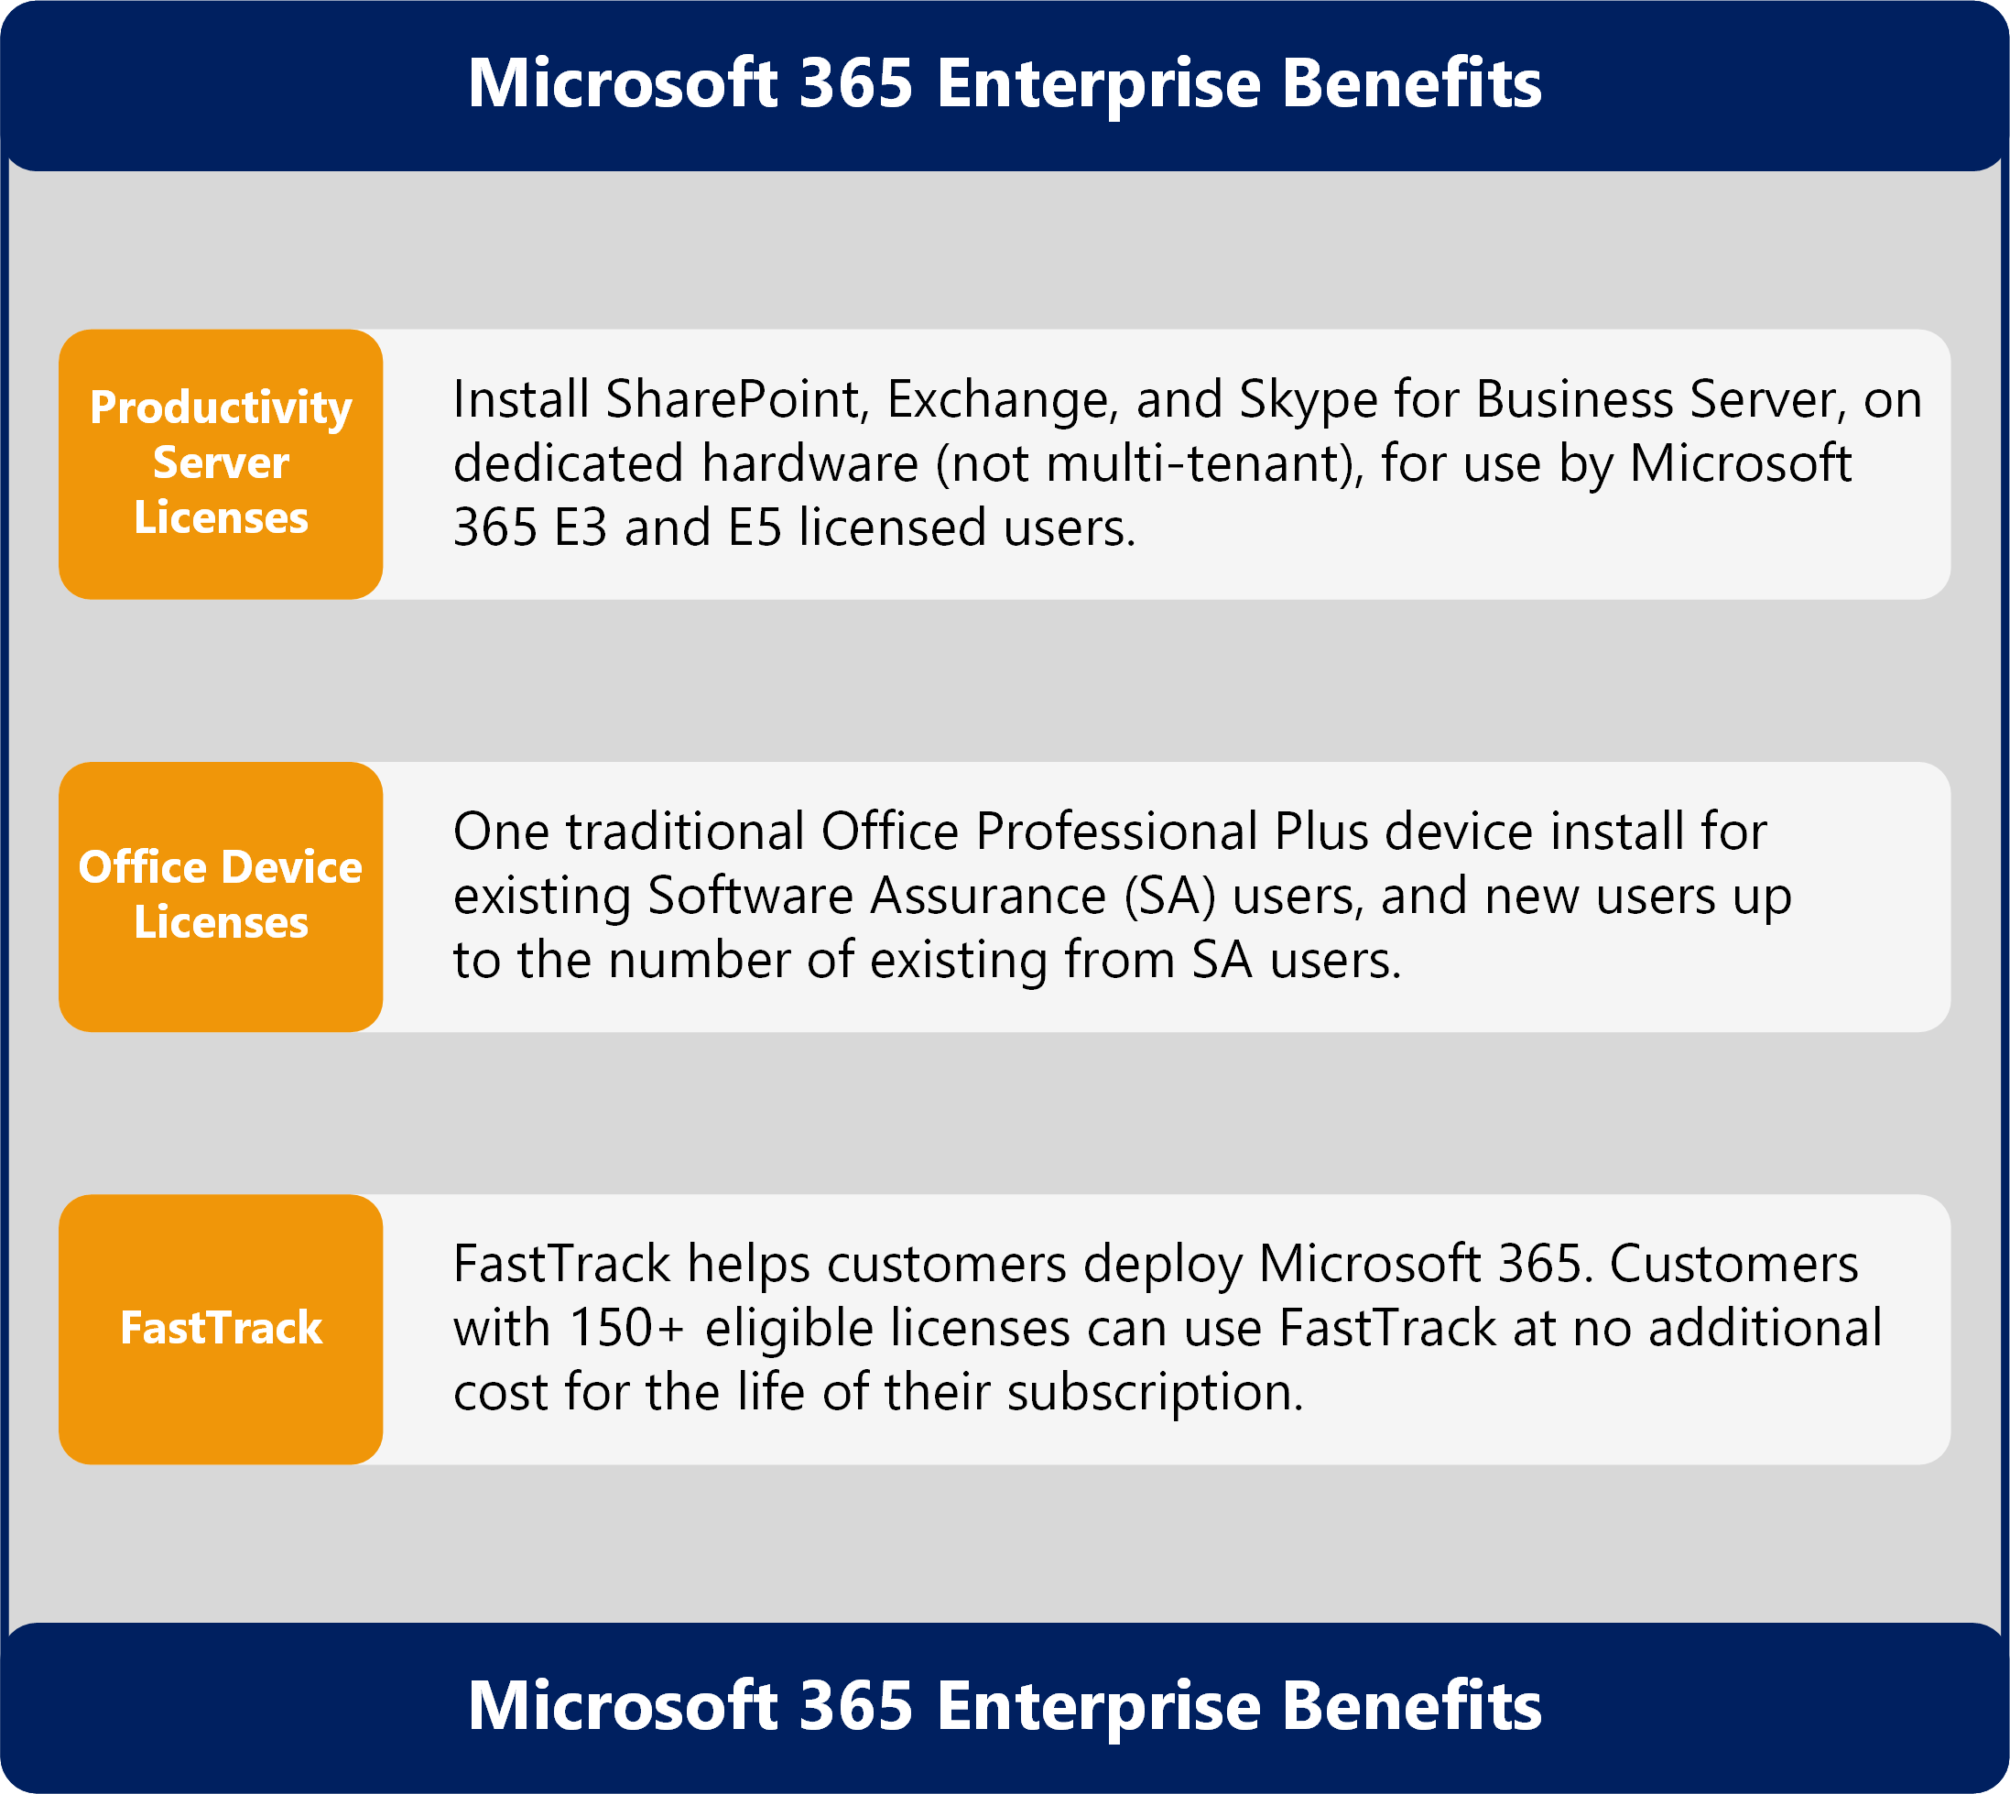
Microsoft 365 Benefits and Additional Licensing
https://github.com/AaronDinnage/Licensing

